Slide 1
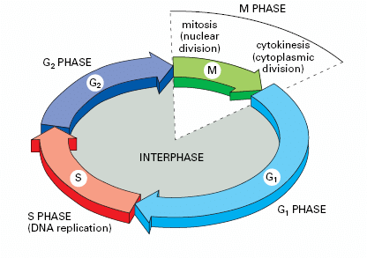
Cell Cycle

Slide 2




PIP-FUCCI
Cell Cycle Analysis; PIP-FUCCI
Accurate Delineation of all cell cycle phases
SiR-DNA
PIP-mVenus
Gem-mCherry
Overlay
Grant et al., Cell Cycle. 2018;17(21-22)

Slide 3
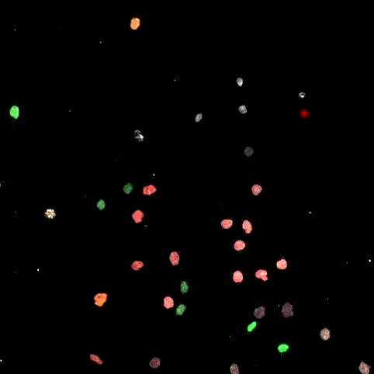
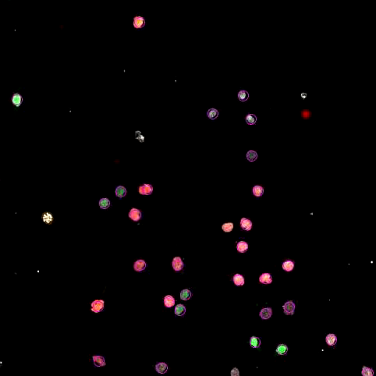
FIJI - TrackMate
Trackmate

Slide 4
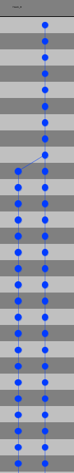
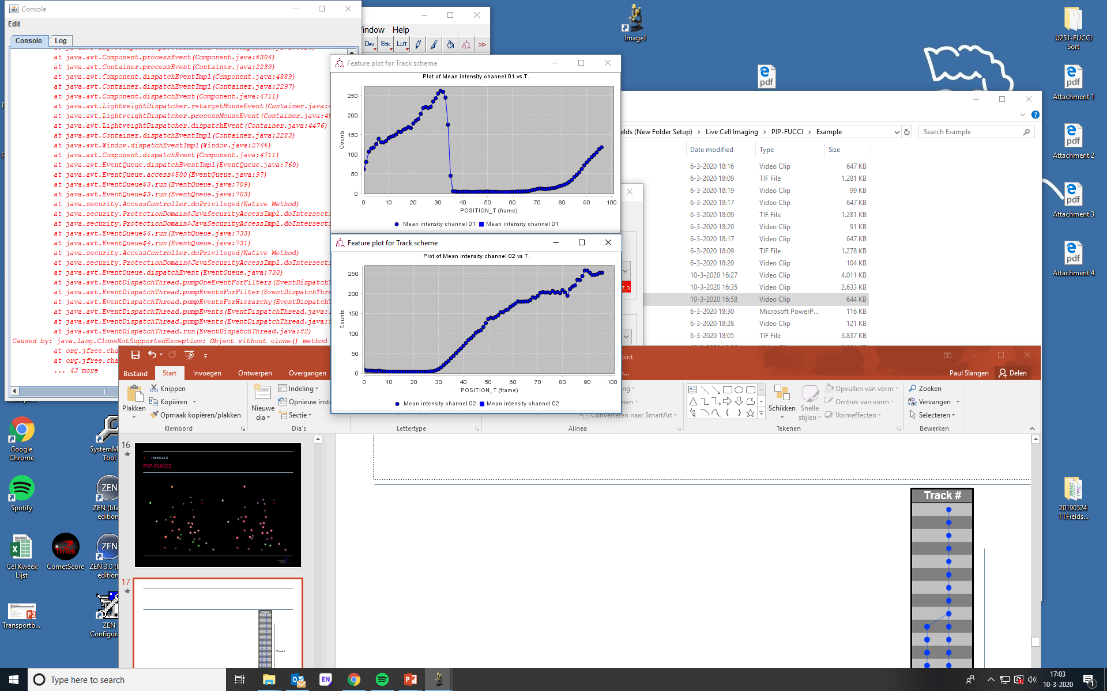
2 Results Analysis of Output Signal
Track #
Frame #
Tinevez et al., Methods. 2017 Feb 15;115:80-90

